Slide 1
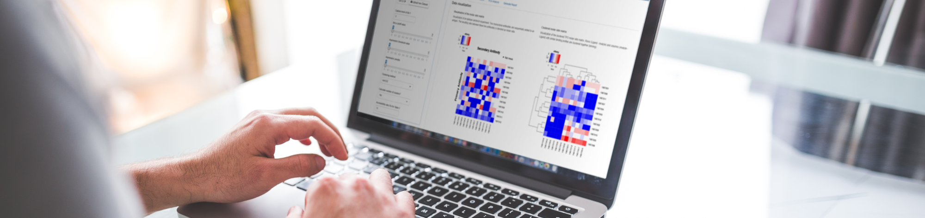
bioWARP
r
Self-service statistics with shiny
Sebastian Wolf – July 17th 2019

Slide 2
biostasticalWebApplicationsRProcedures
inside the Roche Diagnostics Galaxy
Sebastian Wolf – July 17th 2019

Slide 3
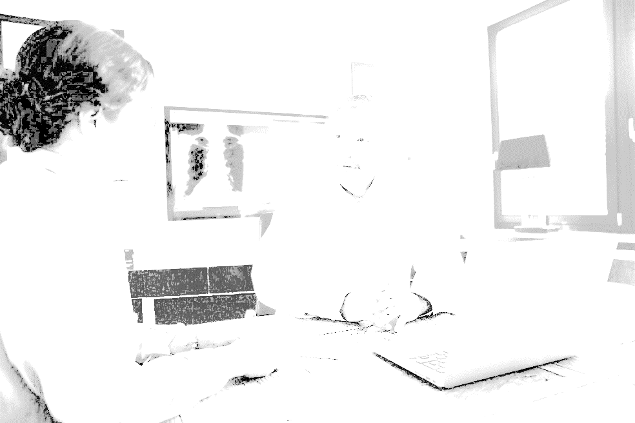


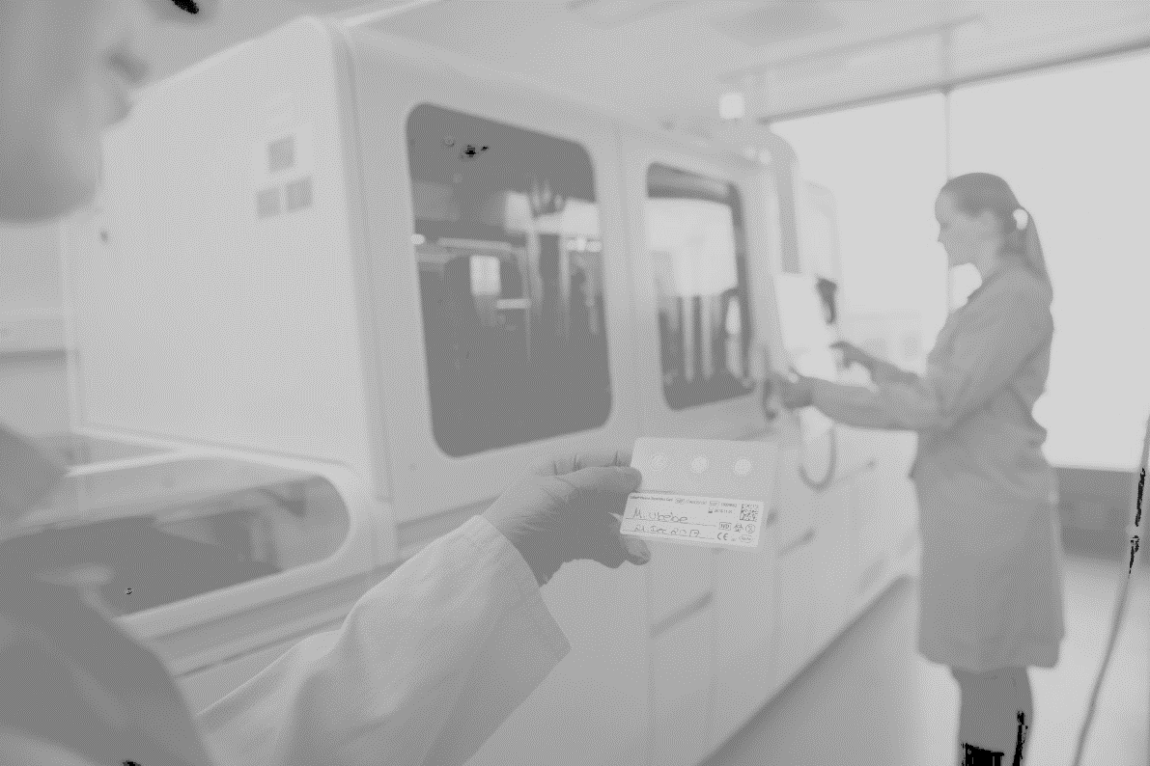
What is the Roche Diagnostics Galaxy?

Slide 4

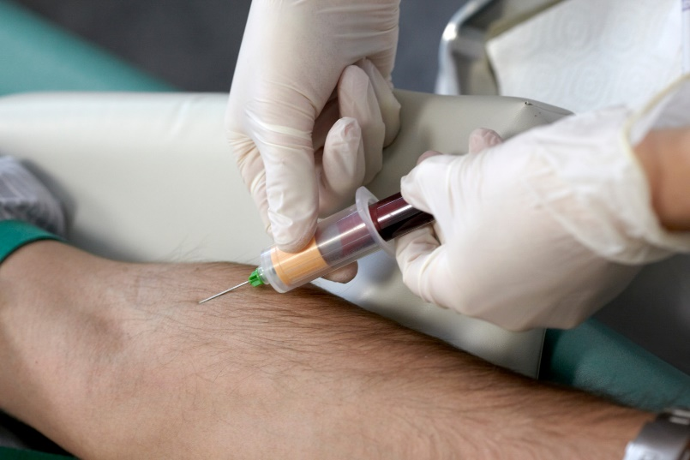
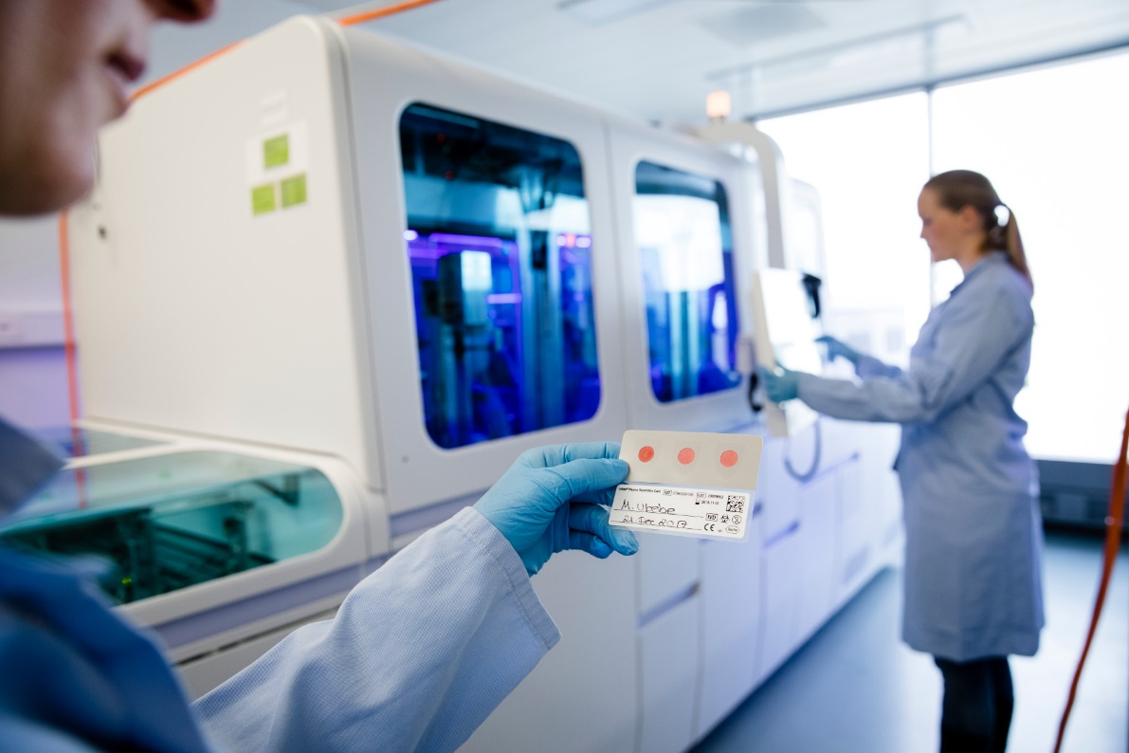
What is the Roche Diagnostics Galaxy?
collect blood
your doctor makes a decision based on the measurements
measure blood parameters with a
Roche Diagnostics device

Slide 5

Mathematical correctness is ensured by multiple planets (institutions)
FDA
CLSI Guideline
SOP
any department`s
data
Biostats
department

Slide 6
SPACE SHIP REQUIREMENTS
SPEED
ROBUSTNESS
CONSTRUCTION

Slide 7
SPEED

Slide 8
SPEED
FDA
CLSI Guideline
Biostats
SOP
any department`s
data
report

Slide 9
SPEED
FDA
by self-Service
Biostats
CLSI Guideline
report
SOP
any department`s
data

Slide 10
SPEED
Simplistic User-interface
Reproducible analysis – Run your analysis again
PDF generation
Help Pages
https://medium.com/@zappingseb/7-steps-that-make-custom-inputs-in-shiny-easy-504b303a2973

Slide 11

SPEED
Measurements with different reagents
Linear Regression
Regression Coefficients
any department
SOP
report
Notes:
You are on your department planet. You have three different reagents and you have one on the market already. The other two are cheaper, but you also want to get them market ready. So you read your SOP which tells you to do a method comparison by Linear Regression. For reporting this, you need Regression coefficients + Confidence intervals.
Now I am going to show you, how to use this example, to make bioWARP robust. #1, you will see how to perform this analysis until the report in bioWARP, #2 I will show you how to do this whole analysis automatically using UI Tests #3 I will show you how we use the UI Tests, to see that for the same data, we get the same regression coefficients.
So, I hope you are ready to start.

Slide 12
SPEED
Report
Demo
R
Data
Notes:
1 Show XML File with -> DATA -> Click Upload -> Compare data frame -> Download PDF
Run ClickTest based on File
Show Rtest Report with at least one failure

Slide 13
SPACE SHIP REQUIREMENTS
SPEED
ROBUSTNESS
CONSTRUCTION

Slide 14
ROBUSTNESS
by automated testing with Rtest and RSelenium
Literature
SAS
R-package
XML
Reference Result
Function call
RTest
Report
RTest
XML
Reference Result
Function call
RSeleniumTest
Report
https://towardsdatascience.com/rtest-pretty-testing-of-r-packages-50f50b135650

Slide 15
ROBUSTNESS
by automated testing in RTest
Plot Checks
Numerical correctness
Many Datasets
R
Usability
Performance Testing
Multi User Simulation
https://towardsdatascience.com/rtest-pretty-testing-of-r-packages-50f50b135650

Slide 16
SPACE SHIP REQUIREMENTS
SPEED
ROBUSTNESS
CONSTRUCTION

Slide 17
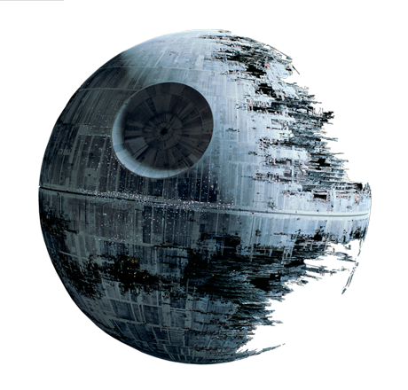
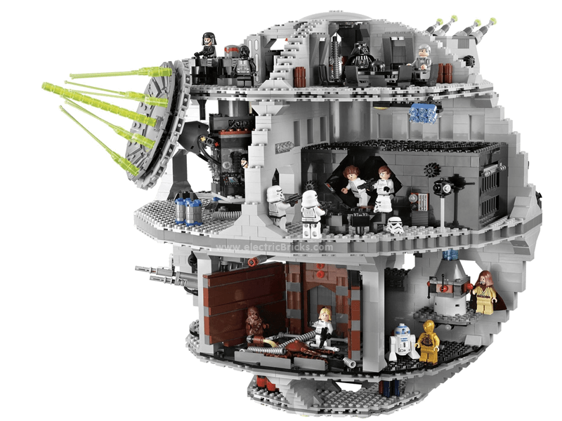
CONSTRUCTION
VS
https://towardsdatascience.com/a-shiny-web-app-from-lego-truck-trailer-c977015bc6a9

Slide 18
CONSTRUCTION
is LEGO like
+ Standardization
+ Modularization
- Specialization
https://towardsdatascience.com/a-shiny-web-app-from-lego-truck-trailer-c977015bc6a9

Slide 19
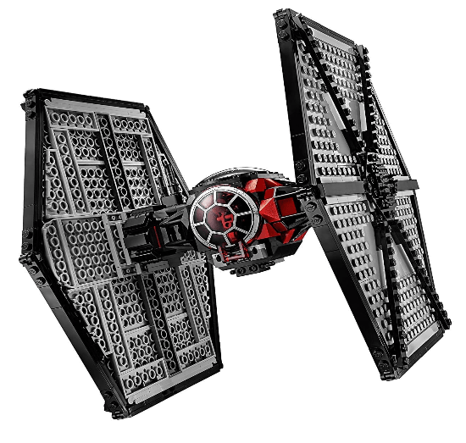
CONSTRUCTION
is LEGO like
Core package
package
MC
DSTAT
S4
MC Interface
class
Regression
Plot
method
Summary table
https://towardsdatascience.com/a-shiny-web-app-from-lego-truck-trailer-c977015bc6a9
Notes:
Core package
Brick defition + construction plan
module packages (extensions)
specialized functionalities
connection to mathematical functions
mathematical packages
From statistics deparment

Slide 20
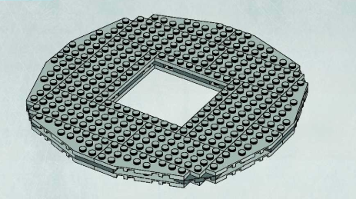
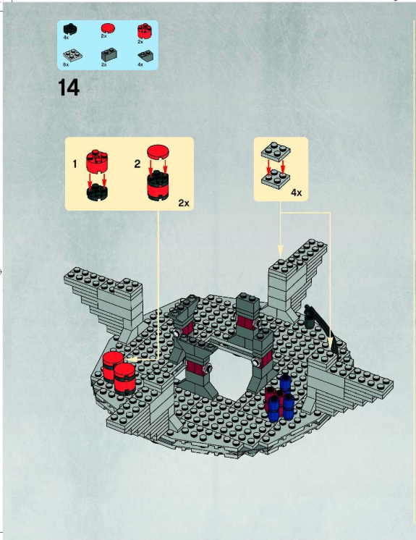
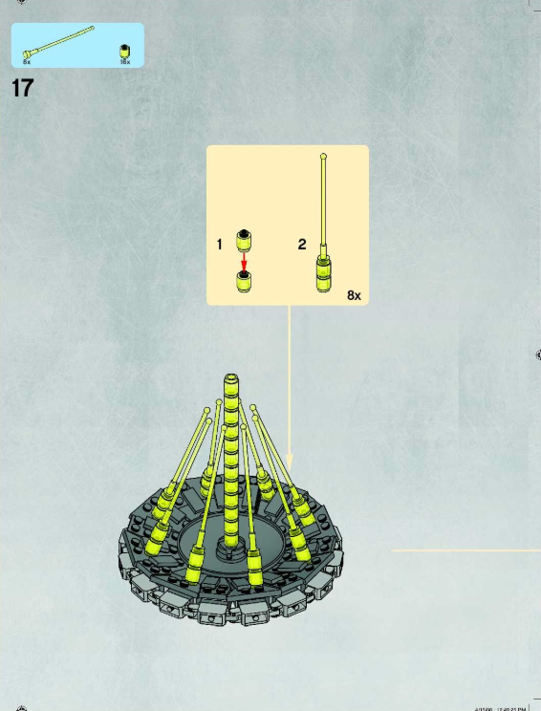
CONSTRUCTION
XML construction plans
XML
Core package
MC
XML
XML
Notes:
In Lego, think of building a different model from the same parts
Who in this room happened to buy a race car, which you can make a pickup. The same is true for bioWARP. You have a construction plan that tells you which plots go into the module, one construction plan that tells you which functions to export from the core package and one construction plan, that tells you which modules to use for your final death star You can choose, death star with or without an extra laser.

Slide 21
SPACE SHIP REQUIREMENTS
SPEED
ROBUSTNESS
CONSTRUCTION

Slide 22
SPACE SHIP REQUIREMENTS

Slide 23
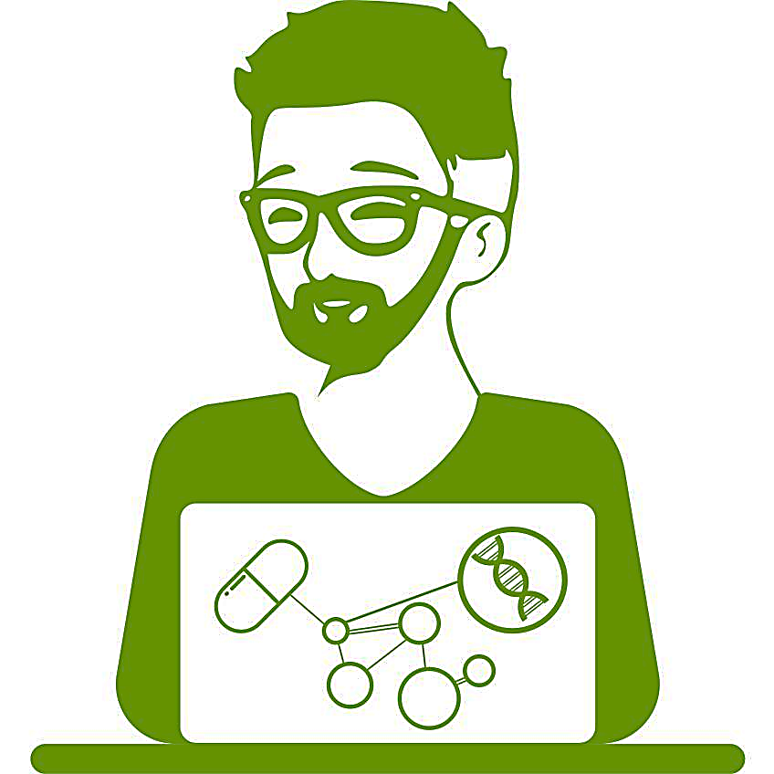
THANK YOU
and may the force be with you
#' @email
#'
#' @blog
#'
#' @bugReport
#'
#' @cv
#'
#' @twitter
sebastian@mail-wolf.de
medium.com/@zappingseb
github.com/zappingseb
linkedin.com/in/zappingseb
twitter.com/zappingseb
r
#' Roche Diagnostics
#' Biostats Penzberg, Germany
#'
#' @productOwner
#' Wilhelm Kleider
#'
#' @developer
#' Alexander Andre
#' alexander.andre@roche.com

